Slide 1

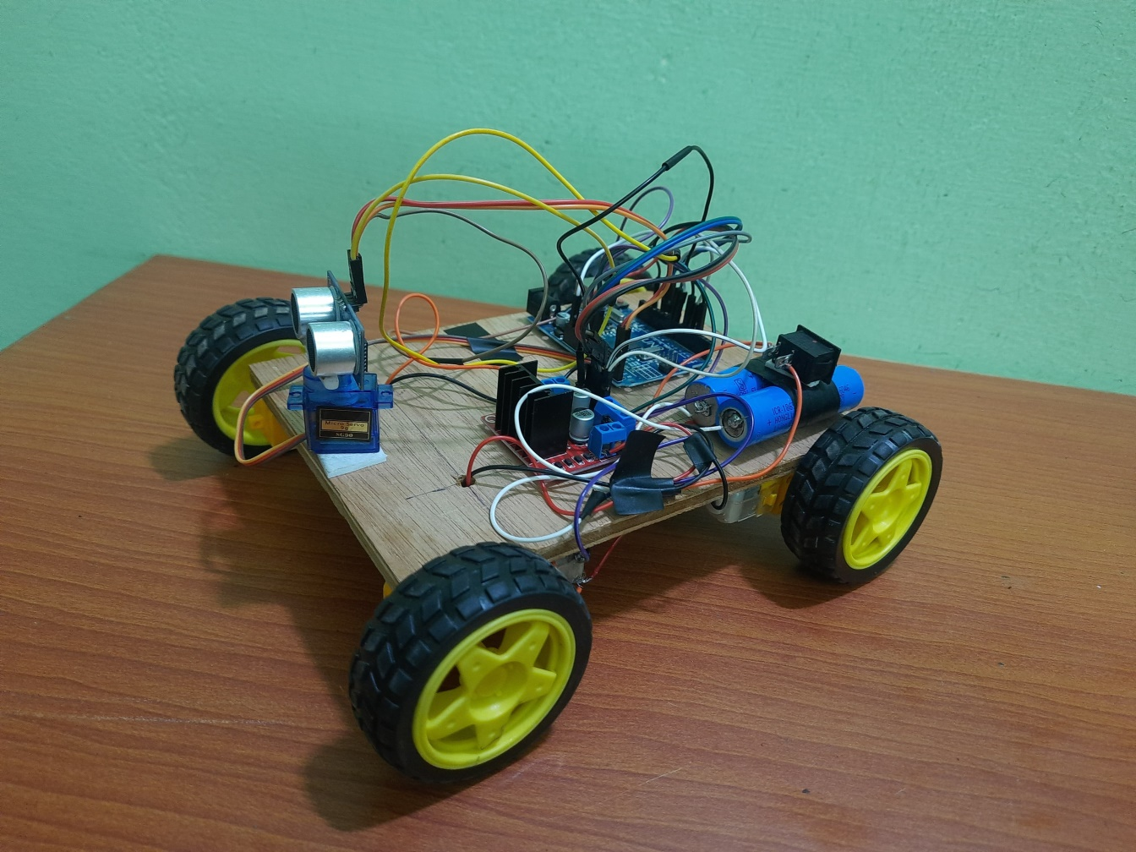
SAFE TRAVERSE: COLLISION FREE INTELLIGENT CAR
TEAM MEMBERS:
AKSHAI KRISHNA A (211521104007)

Slide 2
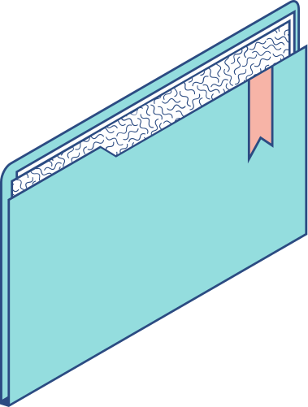
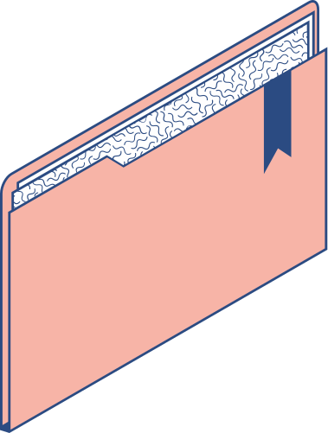
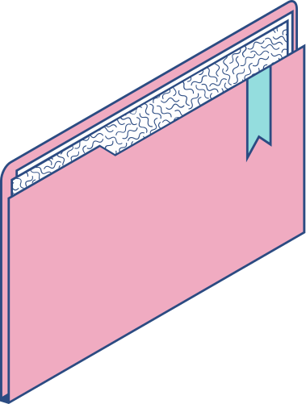
Abstract
"Safe Traverse: Collision-Free Car" is an obstacle-avoiding robot utilizing Arduino Uno, L298N motor driver, servo motor, and ultrasonic sensor. It autonomously navigates, avoiding obstacles for safe traversal. Through sensor fusion and precise algorithms, it negotiates environments effectively. Future iterations may enhance sensor technologies and IoT integration. This project demonstrates the potential of merging hardware and software for intelligent transportation solutions.

Slide 3

COMPONENTS REQUIRED

Slide 4

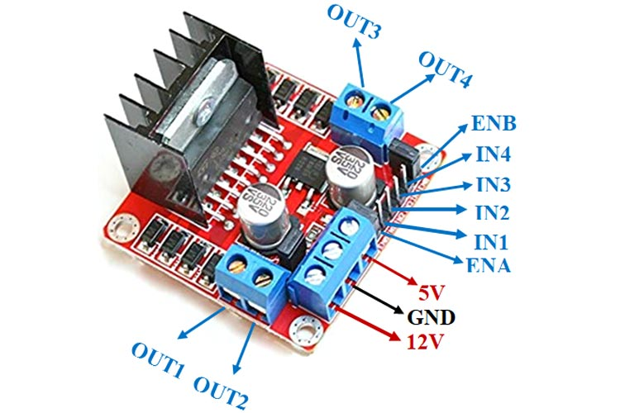
Arduino Uno: An open-source microcontroller board, widely used for building digital devices and interactive objects that can sense and control physical devices.
L298N motor driver: A dual H-bridge motor driver module, commonly used to control the direction and speed of DC motors and stepper motors.

Slide 5
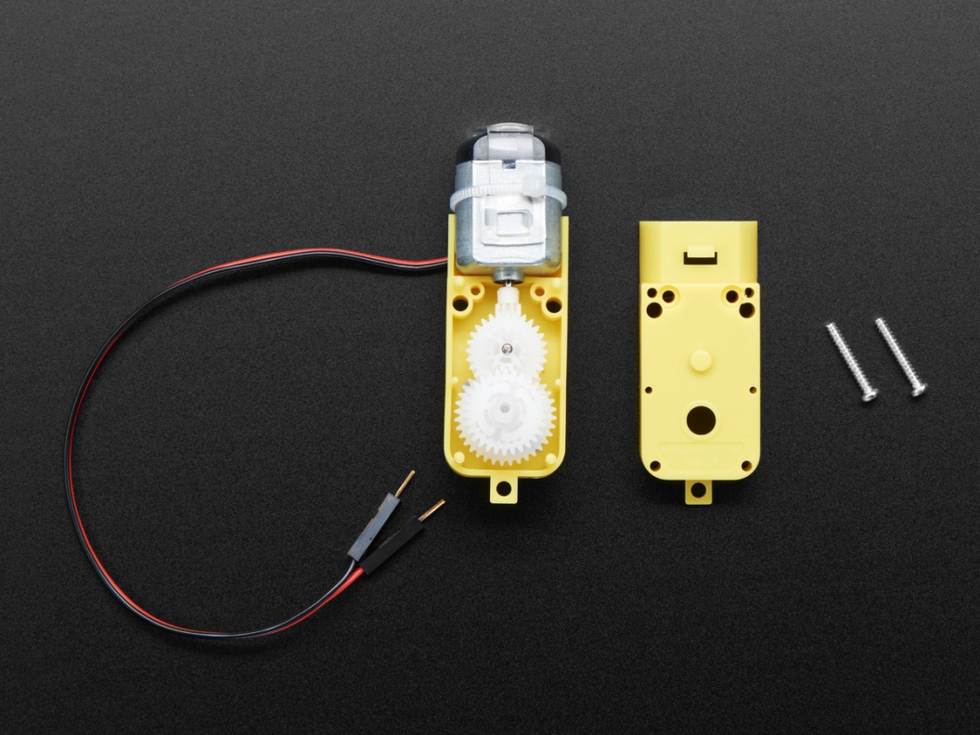
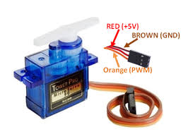
TT gear motors: Geared motors with high torque output, suitable for various robotics and automation applications due to their compact size and efficiency.
Servo motor: A type of motor that allows for precise control of angular position, commonly used in robotics and RC vehicles for tasks such as steering and arm movement.

Slide 6
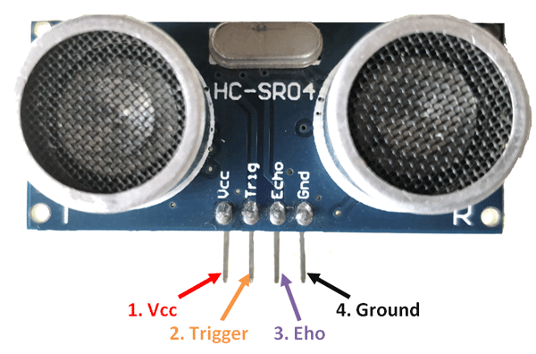
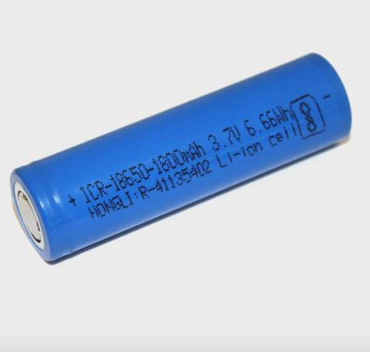
Ultrasonic Sensor: A sensor that measures distance by emitting ultrasonic waves and calculating the time it takes for the waves to bounce back, commonly used in robotics for obstacle detection and navigation.
18650 3.7V Lithium-ion batteries: Rechargeable batteries known for their high energy density and reliability, widely used in portable electronic devices and robotics projects for powering motors and microcontrollers.

Slide 7
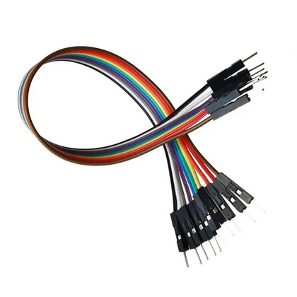
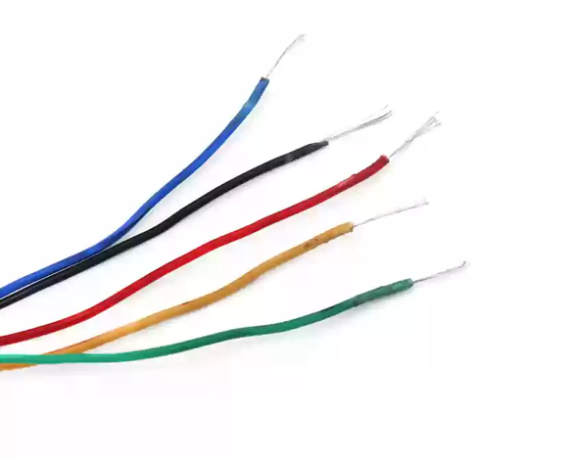
Jumper wires: Jumper wires are used to create electrical connections between components on a breadboard or between components and a circuit board. They come in various lengths and can have male or female connectors.
Connecting wires: Connecting wires facilitate quick and temporary electrical connections between components in circuits, enabling easy prototyping without soldering.

Slide 8

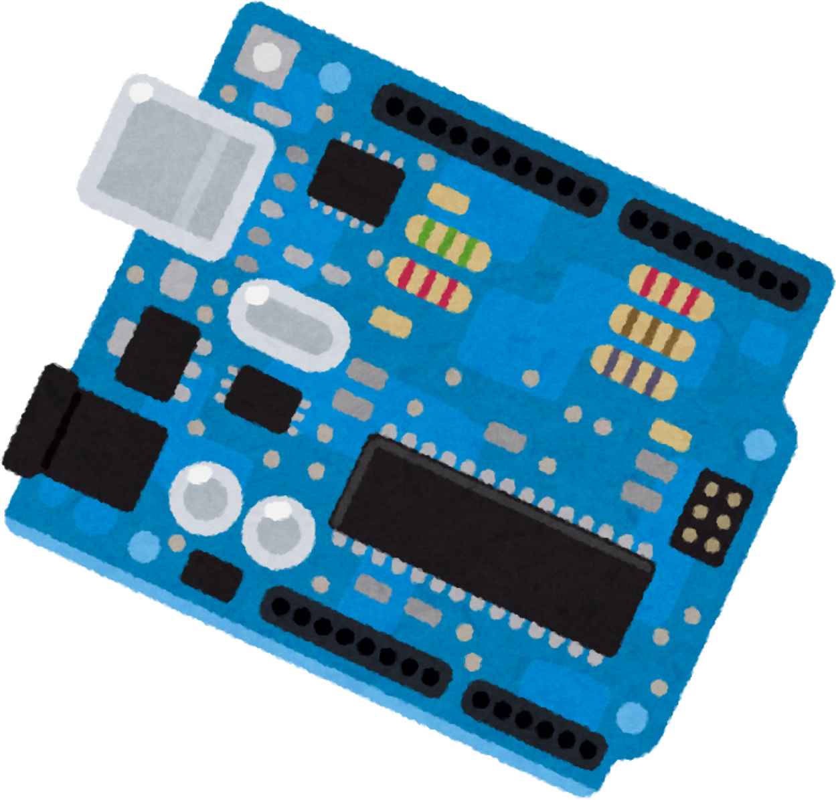

PROPOSED SYSTEM
Autonomous navigation with obstacle avoidance.
Efficient motor control for precision.
Real-time obstacle detection for safety.
Precise steering control for maneuverability.
Reliable power source for sustained operation.
Integration potential with IoT for enhanced functionality.

Slide 9
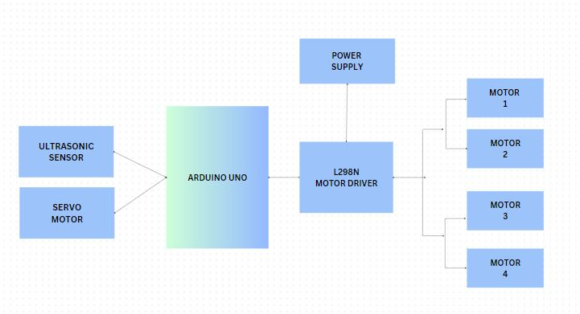
BLOCK DIAGRAM

Slide 10
Steps to assemble
1
2
3
4
5
STEP
STEP
STEP
STEP
STEP
Gather Components and Tools
Connect motors with L298N driver and driver to Arduino
Connect servo motor and setup ultrasonic sensor and connect them to Arduino
Program the Arduino
Install and Test the System

Slide 11
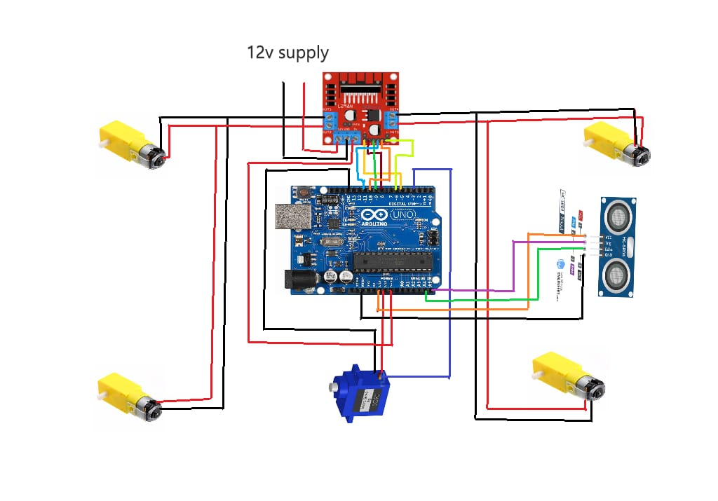
CIRCUIT DIAGRAM

Slide 12
WORKING
System scans environment using ultrasonic sensor.
Detected obstacles trigger avoidance algorithm.
Motor controller adjusts speed and direction.
Servo motor steers vehicle around obstacles.
Continuous monitoring ensures real-time response.
Navigation path dynamically adjusts to surroundings.
Autonomous operation ensures safe traversal.

Slide 13
Safety Boost
Autonomous obstacle avoidance ensures secure traversal.
Efficiency Surge
Real-time navigation adjustments optimize movement.
Versatile Adaptability
Seamlessly maneuvers through diverse environments.
Advantages

Slide 14
APPLICATIONS
Space Rovers | Warehouse Robotics | Agricultural Automation
Navigates extraterrestrial terrain autonomously, aiding in planetary exploration and research. | Facilitates efficient material handling and inventory management in large-scale warehouses, enhancing productivity. | Assists in precision farming tasks such as planting, spraying, and harvesting, optimizing crop yield and resource usage.
Search and Rescue | Environmental Monitoring | Infrastructure Inspection
Maneuvers through hazardous or inaccessible areas to locate and assist individuals during emergencies. | Collects data in remote or hazardous environments to monitor pollution levels, wildlife habitats, and natural phenomena. | Conducts thorough inspections of bridges, pipelines, and other structures to detect defects or damage, ensuring public safety.

Slide 15


